Slide 1
Session 3 - (Quiz Questions)

Slide 2
Q1: The value returned by the input () function is:
An integer
A float
A string
None of above

Slide 3
Q1: Answer
c. a string

Slide 4
Q2: What is the result of the following comparison?
x = 5
y = 10
y = x # assignment statement
print(x == y) #comparison, we use the == operator
True
False
Error

Slide 5
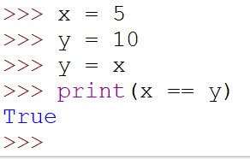
Q2: Answer
A = True

Slide 6
Q3: What is the output of the follow snippet?
x = 5
y = 7
z = 3
x = x + 3
print((y +1) == x)
False
True
Error

Slide 7
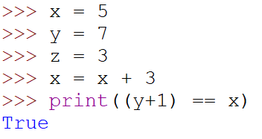
Q3:
b True

Slide 8
Q4: What is the output of the follow snippet?
x = 1
y = 2
print(not (x > 2))
True
False
Not

Slide 9
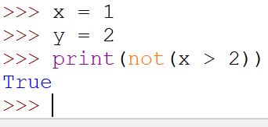
Q4: Answer
a. True

Slide 10
Q5: What is the output of the following snippet?
num = 16
result = 16 >> 2
print(result)
64
8
4
Error

Slide 11
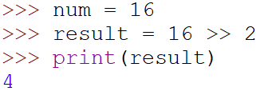
Q5: Answer
c. 4

Slide 12
End of quiz
Any questions?

